Slide 1

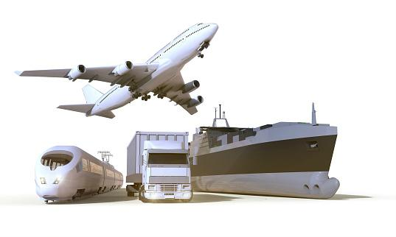
The Cost of Moving Food
Exploring Food Sustainability Through the Lens of Transport
Time, Resources, Environmental Impact and Price
Rachel Manlove
Data Analytics Capstone Project
Nashville Software School
January 2022

Slide 2
Data Sources
U.S. Surface Transportation Board (Rail Service Data)
U.S. Department of Transportation (Average Truck Speeds on Selected Interstate Highways: 2009)
U.S. Department of Energy (Motor Vehicle Mileage, Fuel Consumption, and Fuel Economy)
U.S. Department of Energy (Short-Term Energy Outlook, December 2021)
U.S. Department of Energy (Carbon Dioxide Emissions Coefficients by Fuel)
The Geography of Transport Systems, by Jean-Paul Rodrigue (Fuel Consumption by Containership Size and Speed)
The Conservation Fund (Moving Freight: Economy and Atmosphere)
The National Air and Space Museum (How Things Fly)
The Engineering Toolbox (Combustion of Fuels- Carbon Dioxide Emission)

Slide 3
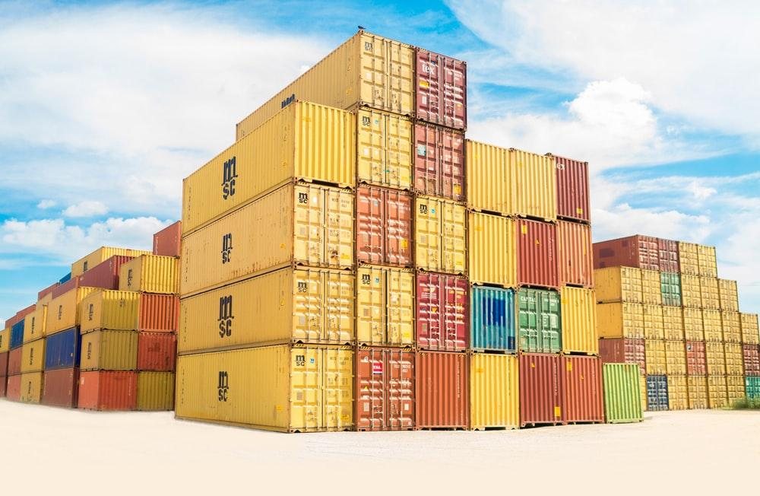
Data Questions
How fast does cargo travel via different methods?
How much fuel does it take to move cargo by these methods?
How much CO2 is produced to move this cargo?
How much is spent (USD) on fuel to move our food-centric cargo?

Slide 4
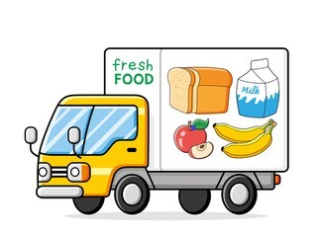
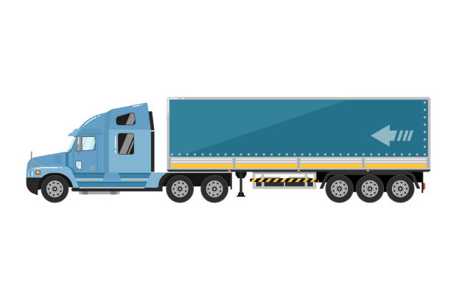
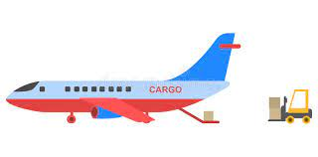
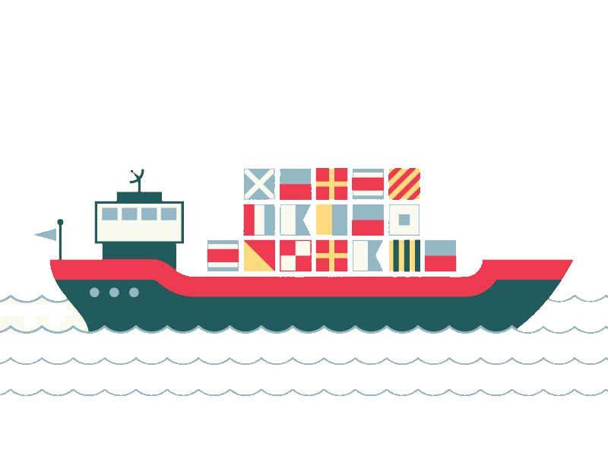
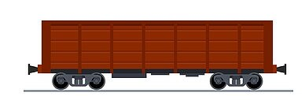
Challenges
Variable diversity within the scope of my data questions
Many of my questions center on how much fuel is consumed when moving cargo, but that depends upon the kind of fuel being used, the kind of vessel using it, and how much total weight that vessel is carrying
Variable diversity within the data itself
Some fuel measurements were listed in tons, others in gallons; different types of fuel weigh different amounts
Fuel consumption levels were sometimes provided by amounts of fuel consumed by day, other times by hour, and other times by distance
Speed data was listed in kilometers per hour, miles per hour, and nautical knots across different data sets and different transportation types
The weight of a shipping container, or how much weight a transport vessel is carrying, can vary significantly depending upon what is in the container, necessitating a consistent method of determining averages in cargo weights across my datasets

Slide 5
Methodology
Convert all speeds to miles per hour (MPH)
Convert all fuel measurements to gallons
Determine average weights for cargo loads - convert all to tons
Methodology varied by transit type (see README for further details)
Filter all information through the lens of efficiency via ton-mile
Calculated by multiplying how much weight a vessel is carrying by the miles-per-gallon of that vessel

Slide 6
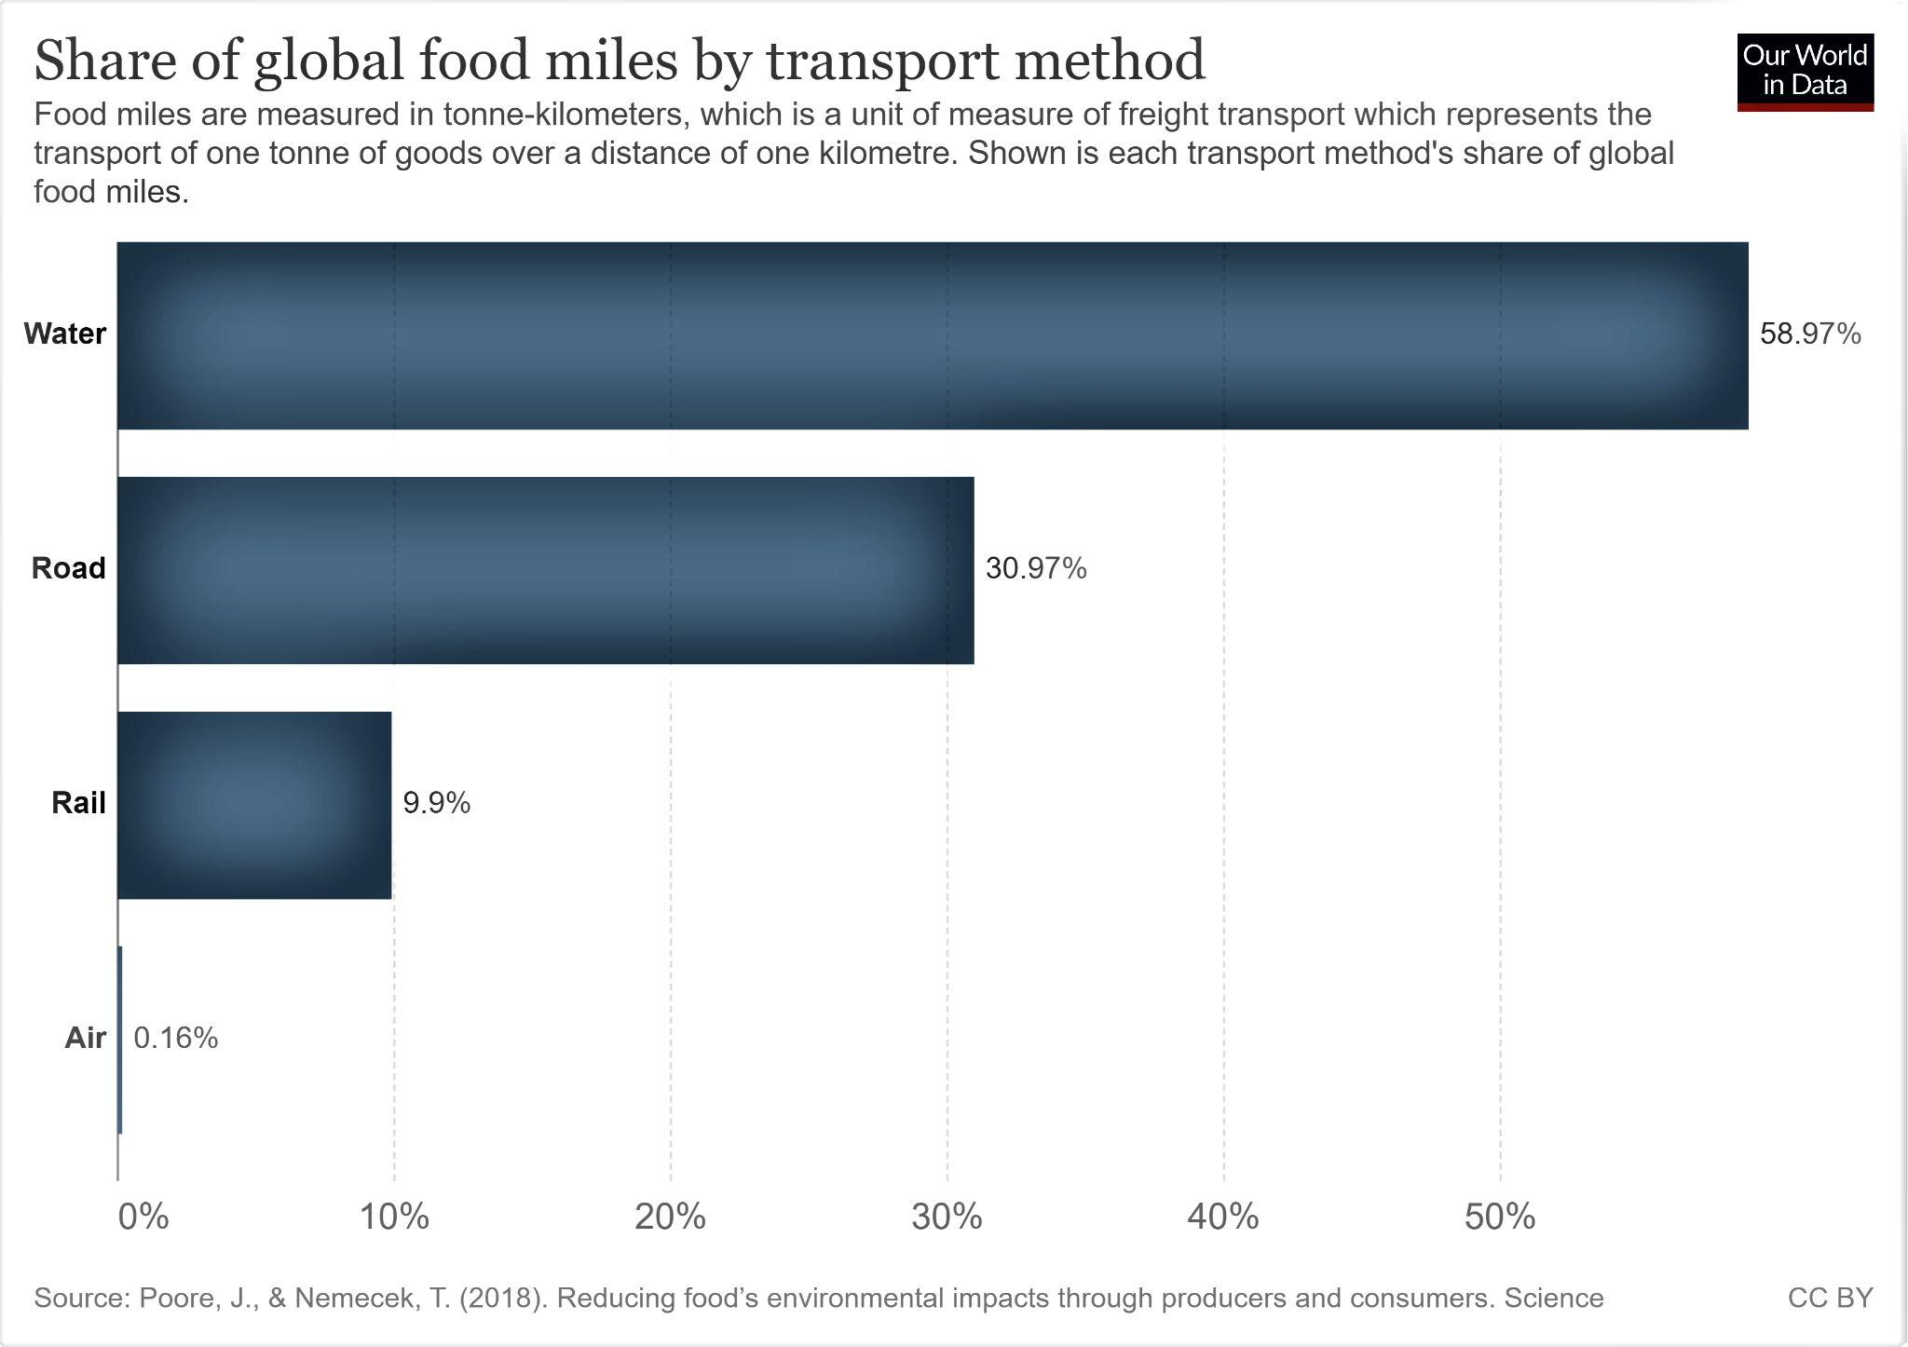
Where to start:
How does food get from the source to the market?

Slide 7
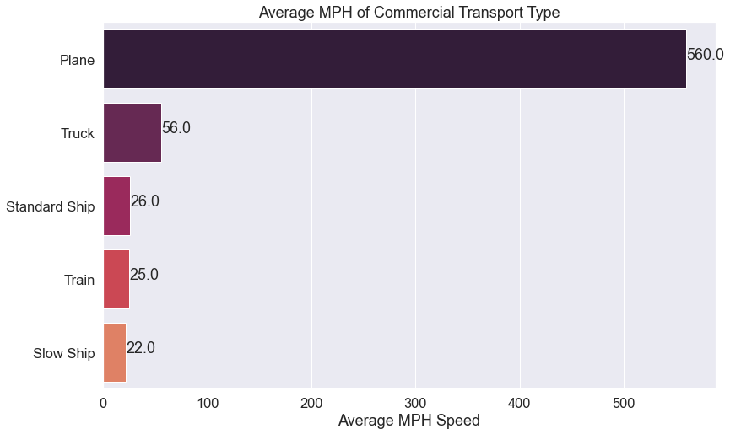
How fast does food travel by these different methods?
There is a growing trend of cargo ships traveling at lower speeds to improve fuel efficiency for each vessel
Notes:
The standard cruising speed of a cargo ship is between 20-25 knots, averaging out to about 23 knots, or 26mph. But, companies are increasingly asking their captains to travel at lower speeds - between 18 and 20 knots, or about 22mph on average, in order to save fuel.

Slide 8

How fuel efficient are these modes of transport?
How many miles per gallon (MPG) does each type get?
IT DEPENDS
Smaller Truck 10 tons 10 mpg
Larger Truck 20 tons 7 mpg
2 gallons
10 mi.
2 gallons
14 mi.
Notes:
The example often given is to consider two trucks. A smaller truck that carries 10 tons of cargo and gets 10mpg. And a larger truck that carries 20 tons of cargo and gets only 7mpg. Looking at just mpg, it looks as though the smaller vehicle is more efficient - but for those smaller trucks to carry the same amount of cargo as the larger trucks, it would take another gallon of fuel vs. the larger truck’s one. MPG alone is not the best lens through which to determine fuel efficiency.

Slide 9
How fuel efficient are these modes of transport?
How many miles can a ton of cargo travel on a gallon of fuel (on average)?

Slide 10
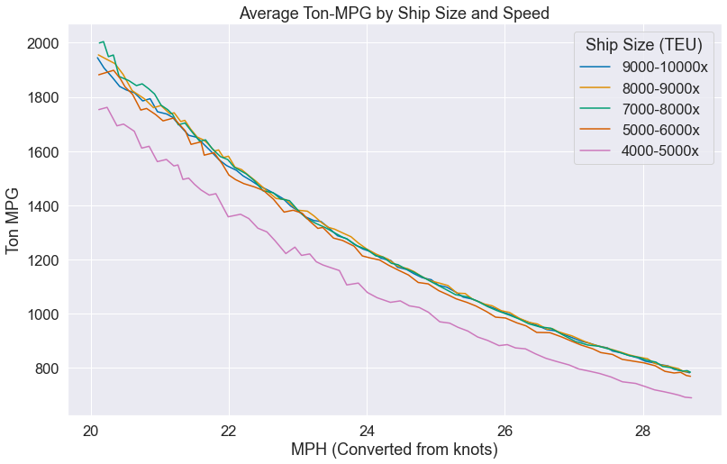
How many miles can a ton of cargo travel on a gallon of fuel (on average)?

Slide 11
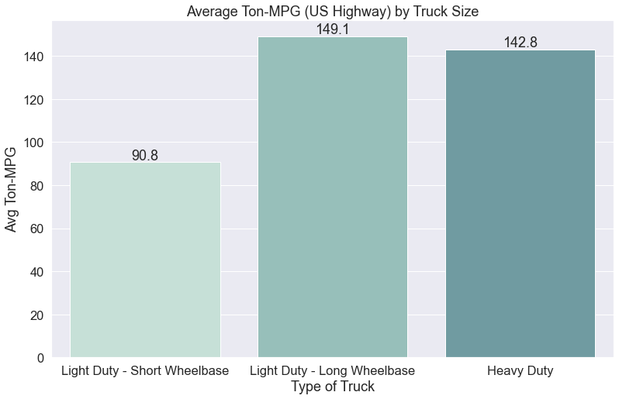
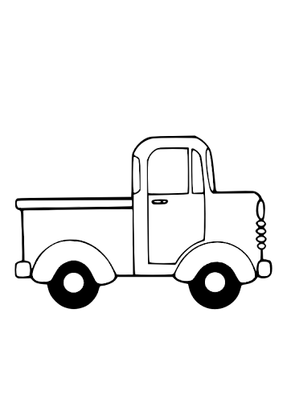


How many miles can a ton of cargo travel on a gallon of fuel (on average)?

Slide 12
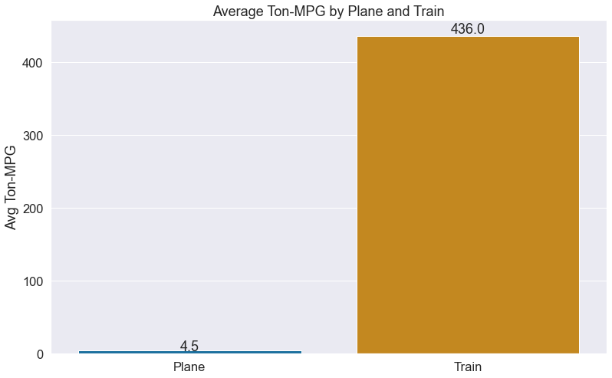
How many miles can a ton of cargo travel on a gallon of fuel (on average)?

Slide 13
What kind of environmental impact do these different methods of transport have?
The most direct impact when discussing transport, are greenhouse gas emissions from fuel consumption
Fuel = carbon = CO2
For every pound of carbon burned, three pounds of CO2 are produced
Notes:
Harmful greenhouse gasses are Carbon Dioxide, Methane, and Nitrous Oxide. With fuel, we’re primarily dealing with CO2.

Slide 14
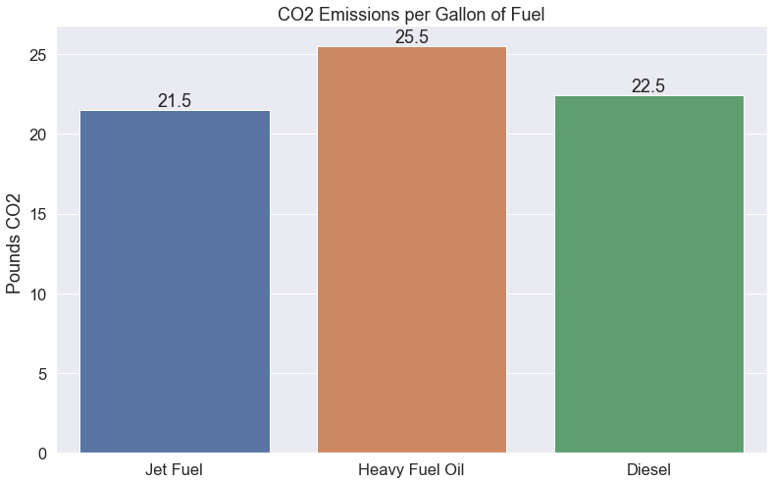


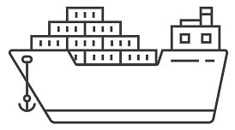

Slide 15

How much does fuel cost?

Slide 16
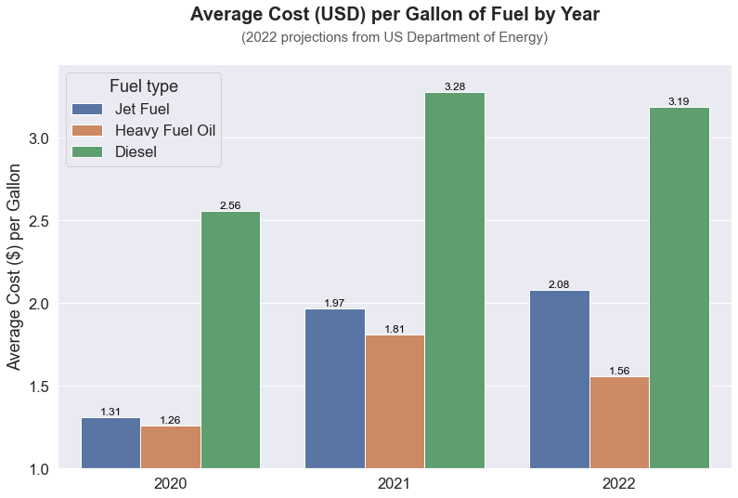
How much does fuel cost?

Slide 17
What does this all mean?
How is all this data relevant to any decisions I make?
Leopold Center for Sustainable Agriculture Iowa State University, 2001 “Food, Fuel, and Freeways: An Iowa perspective on how far food travels, fuel usage, and greenhouse gas emissions”
Average Distances from Farm to Market
Terminal Market vs. Ferry Plaza Farmers Market
Apples: 1,555 miles vs. 77 miles
Tomatoes: 1,369 miles vs. 117 miles
Grapes: 2,143 miles vs. 134 miles
Beans: 766 miles vs. 101 miles
Peaches: 1,674 miles vs. 173 miles
Winter Squash: 781 miles vs. 98 miles
Greens: 889 miles vs. 99 miles
Lettuce: 2,055 miles vs. 102 miles

Slide 18
What’s the overall impact (1-Ton/1000 miles)?
Fast Ship
Slow Ship
Small Truck
Medium Truck
Big Truck
Plane
Train
Time (Hours)
38.5
45.5
17.9
17.9
17.9
2
40
Gallons of Fuel
.99
.63
11
6.7
7
222.2
2.3
CO2 (lbs)
25.37
16.18
247.5
150.7
157.3
4777.8
51.5
Fuel cost 2021
1.80
1.15
36.14
22.00
22.97
437.78
7.52
Is this really the best option?
Notes:
For the ships, I chose the best mileage from all 5 size categories.
So, if you’re looking to move food over long distances, the best method is by a slow-moving ship.

Slide 19
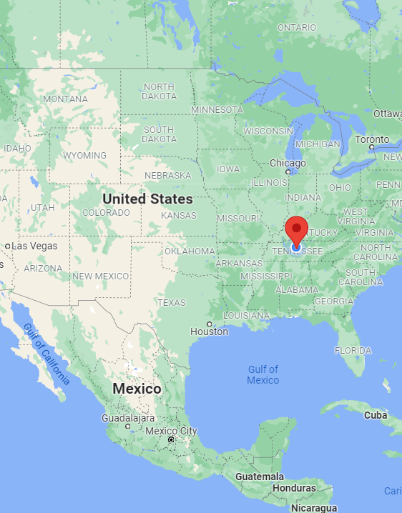
Fast Ship
Slow Ship
Small Truck
Medium Truck
Big Truck
Plane
Train
Time (Hours)
38.5
45.5
17.9
17.9
17.9
2
40
Gallons of Fuel
.99
.63
11
6.7
7
222.2
2.3
CO2 (lbs)
25.37
16.18
247.5
150.7
157.3
4777.8
51.5
Fuel cost 2021
1.80
1.15
36.14
22.00
22.97
437.78
7.52
Is this really the best option?
Notes:
In general, yes. If you need to move large amounts of food across large distances, boat is the way to go

Slide 20
Transporting food by Ship or Train
vs. Locally by Truck:
Pros:
Fuel efficient over long distances
Cons:
Slow
Less distance = faster delivery time
Produce is fresher/riper
More carbon emissions per gallon using diesel trucks
Fewer gallons/emissions overall by cutting transit distance
Effective at moving large amounts at once
Food most likely processed or under-ripe: less nutritious *unless frozen
Less CO2 production - by cargo weight
Ship and Train is not the end point of that cargo’s journey

Slide 21
Sustainability
Finding a balance between how much food is imported over large distances and how much food is sourced locally
Emphasis on obtaining a greater % of food from local sources
Minimizing fuel usage, CO2 emissions, and spending less $$ on transportation of food-cargo

Slide 22
Areas for Further Analysis
Refine the data for transit by truck by including data for urban driving conditions
Are shipping companies actually saving fuel and money by traveling slower
Started the practice during the 2008 Recession
Individual ships save on fuel, but do companies?
Does slower ships = less profit? Larger fleets?
It would be fascinating to further examine where exactly different ingredients are grown and how exactly they’re transported, to get a clearer vision of a food-product’s journey from origin to market
Shipping ports mapped
Rail lines mapped
Distribution centers highlighted

Slide 23
Questions
?

